Slide 1
Database – Evaluating schema quality
Guidelines
Normalization

Slide 2
Informal guidelines
Make sure that the meaning of a table is clear. Information about different things should be placed in different tables.
Reduce redundant information in tuples
lead to anomalies , i.e. problems at the insertion, update and deletion of data
waste of storage
Reduce NULL values
unexpected join results
multiple interpretations
waste of storage
Avoid generation spurious data during JOIN

Slide 3
2. Reduce redundant values
Anomaly: something that leads to unexpected and/or unpredictable results.
Types of anomalies :
Insert: when we only want to insert part of the data / when we need to match data already inserted
delete: when a value we want to delete also means we will delete values we wish to keep.
update: when we want to change a single data item value, but must update multiple entries
Need to check your database design carefully:
the database should be anomaly free.

Slide 4

Redundancy and anomalies

Slide 5
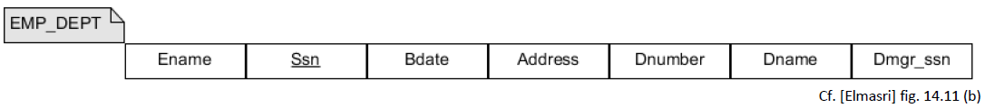
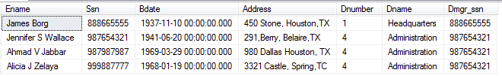
Example redundancy and anomalies

Slide 6
Normalization
Formally measure why one set of groupings of attributes into relation schemas is better than another

Slide 7
Normalization
We look at:
1NF, 2NF, 3NF and Boyce-Codd Normal Form (BCNF) Based on functional dependencies
We don't look at
4NF could have been considered
5NF and 6NF
Idea normal form
No anomalies, no lost information
3NF and BCNF are the most interesting in practice
3NF and BCNF eliminate redundancy

Slide 8
First normal form 1NF
Qualifications for 1NF are:
Each column must have a unique name
The order of the rows and columns doesn’t matter
Each column must have a single data type
No two rows can contain identical values
Each column must contain a single values
Columns cannot contain repeated groups
Source: Beginning Database design Solutions, Rod Stephens

Slide 9
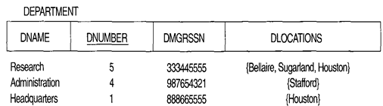
A relation that is not in 1NF
Remedy:
Form new relations for each multivalued attribute or nested relation

Slide 10
Functional Dependency (FD)
Examples:
Ssn -> Ename The value of the employee’s Social Security number (Ssn) uniquely determines the employee name
Pnumber -> {Pname, Plocation}
The value of a project’s number (Pnumber) uniquely determines the project name and location
CPR nummer bestemmer navn

Slide 11
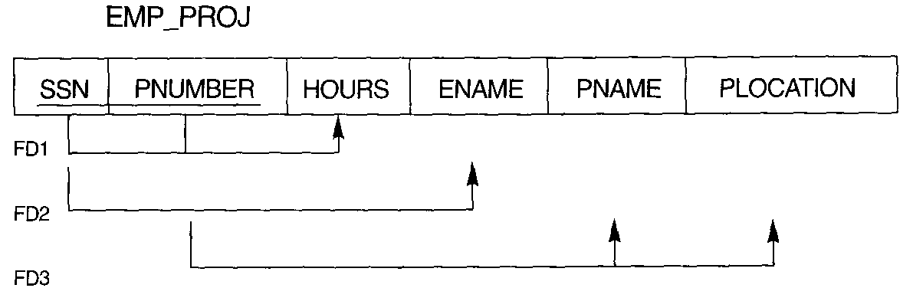
Examples of FD constraints
FD1: {SSN, PNUMBER} → HOURS Ssn and project number determines hours
FD2: SSN → ENAME Social security number determines employee name
FD3: PNUMBER →{PNAME, PLOCATION} Project number determines project name and location

Slide 12

Second Normal Form 2NF
Relevant only if the key consists of more than 1 attribute (composite key)
All attributes in the relations must be functional dependent of the whole key - and not by part of the key
“All of the non-key fields depend on all of the key fields”

Slide 13
Normalize to 2NF
Decompose and set up a new relation for each partial key with its dependent attribute(s).
Make sure to keep a relation with the original primary key and any attributes that are fully functionally dependent on it.
Decompose:

Slide 14

Third normal form 3NF
It is in 2NF
It contains no transitive dependencies
A transitive dependency is when one non-key field’s value depends on another non-key field’s value.
“Any non-key must only depend on the primary key”
?

Slide 15
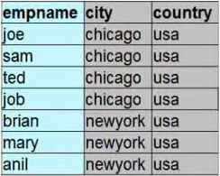
Third Normal Form
Counterexample : not in 3NF
Job( empname, city, country)
FD: city → country
Redundant that Chicago is in USA
https://www.youtube.com/watch?v=U-F_fRJ_YTQ&nohtml5=False

Slide 16
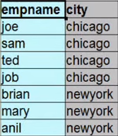

Third Normal Form
Counterexample : now in 3NF
Job (empname, city)
CityLocation (city, country)
https://www.youtube.com/watch?v=U-F_fRJ_YTQ&nohtml5=False

Slide 17
Boyce-Codd Normal Form (BCNF)
Boyce-Codd Normal Form (BCNF)
A relation is said to be in BCNF if
The relation is in Third Normal Form (3NF)
And every determinant is a candicate key
For each A -> B , A is a key
For all functional dependencies, it must be the case that the determinant is a candidate key.
The data you store in a table must depend on the key, the whole key and nothing but the key
“So help me Codd”
candicate key?
https://www.youtube.com/watch?v=G5lHTPRSSto&nohtml5=False

Slide 18
Nearest shops – 3NF but not BCNF
Person | ShopType | NearestShop
Pedersen | Optician | ProfilOptik
Pedersen | Hairdresser | SalonHair
Nielsen | Bookshop | BogHandel
Jensen | Bakery | GuldBager
Jensen | Hairdresser | Klipotetek
Jensen | Optician | ProfilOptik
NearestShop | ShopType
ProfilOptik | Optician
SalonHair | Hairdresser
BogHandel | Bookshop
GuldBager | Bakery
Klipotetek | Hairdresser
The candidate keys of the table are:
{Person, Shop Type}
{Person, Nearest Shop}
The FDs are:
Person, ShopType -> NearestShop
NearestShop-> ShopType
NearestShop | Person
ProfilOptik | Pedersen
SalonHair | Pedersen
BogHandel | Nielsen
GuldBager | Jensen
Klipotetek | Jensen
ProfilOptik | Jensen
Employee -> Place
Project -> Place
source: Wikipedia

Slide 19
BCNF vs 3NF
BCNF
Stricter than 3NF
3NF
Always allows join lossless and dependency preserving
May allow some anomalies
“In practice, most relation schemas that are in 3NF are also in BCNF”

Slide 20
Is normalization a must ?
If the domain model is well thought out then the schema derived from transformation rules are normally good. Still check it.
If a relation is not in the desired normal form - then decompose it
Source: http://www-db.deis.unibo.it/courses/BDPG/normaliz.pdf

Slide 21
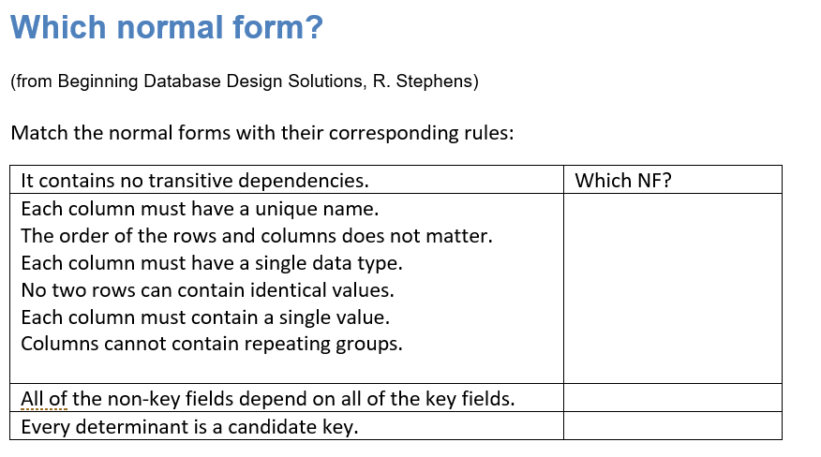
ExerciseNormalization

Slide 22
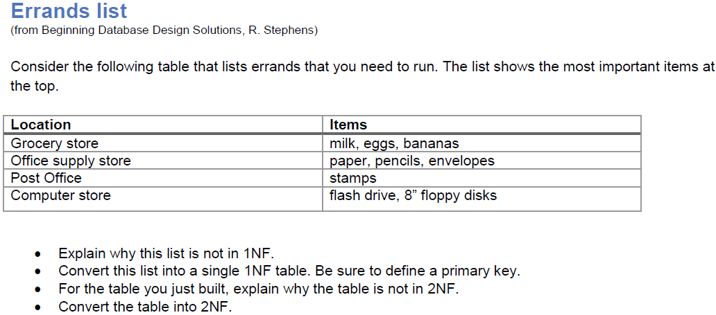
ExerciseNormalization

